Slide 1
Data Analysis on SPSS

Slide 2
What is SPSS ?
(Statistical Package for the Social Sciences), also known as IBM SPSS Statistics, is a software package used for the analysis of statistical data.

Slide 3
IMPORTANT FEATURES OF SPSS
Data Management:
SPSS allows you to import data from a variety of sources, including spreadsheets, databases, and text files. You can also clean and manipulate your data in SPSS, such as recoding variables, creating new variables, and handling missing data.
Data Visualization:
SPSS offers a wide range of tools for creating charts and graphs to help you visualize your data. This can be helpful for identifying patterns, trends, and relationships in your data.
Analysis:
SPSS offers a comprehensive set of statistical procedures, including descriptive statistics, hypothesis testing, regression analysis, and more. You can use SPSS to analyze complex data sets and answer your research questions.

Slide 4
Easy to Use Interface:
SPSS has a user-friendly interface that makes it easy to learn and use, even for those with no prior experience with statistical software.
Output Customization:
SPSS allows you to customize your output to include the information you need. You can create tables, charts, and graphs that can be easily exported to other software programs.
Integration with Other Software:
SPSS integrates with other IBM SPSS products, as well as with other statistical software programs, such as R and Python. This allows you to use SPSS in conjunction with other tools to perform more complex analyses.
Syntax Editing:
While SPSS offers a menu-driven interface, it also allows you to write syntax to automate tasks. This can be helpful for experienced users who want to perform repetitive tasks more quickly.

Slide 5
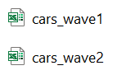
Two data set :
cars_wave1.xls cars_wave2.xls
200 sample size
ID from 1 to 200
200 sample
ID from 201 to 406
Both tables contain same 9 variables / attributes/ column Name

Slide 6
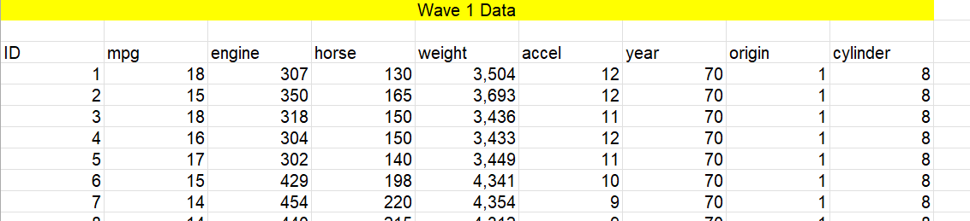
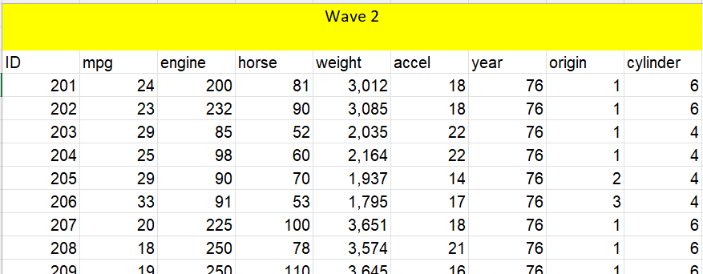
These Dataset is about of Cars , its features & attributes.

Slide 7
Steps before Importing data in SPSS
Collect the data
Investigate the dataset
Cleaning and Transformation ( dealing with missing and unwanted cases/ values )

Slide 8
Importing data in SPSS
Import the two files and merge them:
Open the SPSS software and select the icon from the top left corner. A new window will pop up.
Select the folder were you have saved the file and also select the file type.
3.Select the file and then click on Open.
4.Then repeat the same process for opening the second file.
5.Open the first file on SPSS, then select Data > Merge Files > Add Variables.

Slide 9
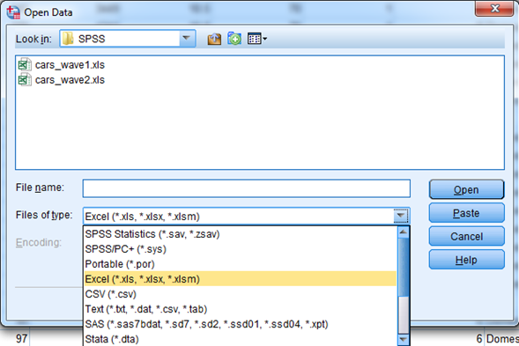
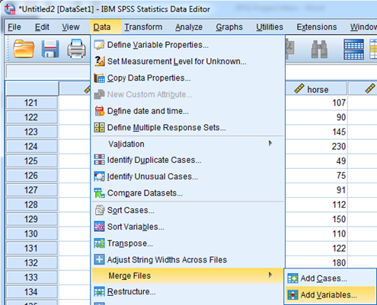

Slide 10
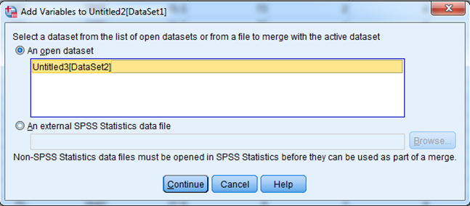
A new window will pop up.
Select the second file and then click on Continue.
The two files would be merged successfully.
Save the new data-set in your desired folder.

Slide 11
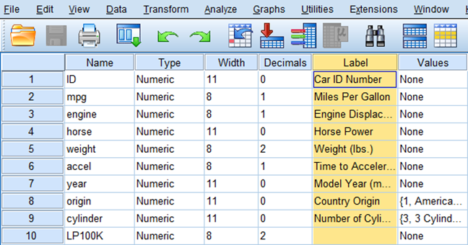
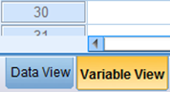
Defining the proper attributes:
Select Variable View from the bottom left corner.
Also changed the Measure section according to the given data.

Slide 12
Assign Labels for the code numbers of origin (1,2 and 3)

Slide 15

Converting Miles Per Gallon (mpg) to Liters Per 100 Kilometers:
Select Transform > Compute Variable. A new menu will appear.
1. Under the Target Variable section, write LP100K. Then under the Numeric Expression section, enter the formula: (100*3.785)/(1.609*mpg)
2. Click on OK. Hence, you can see a new column as LP100K.

Slide 16
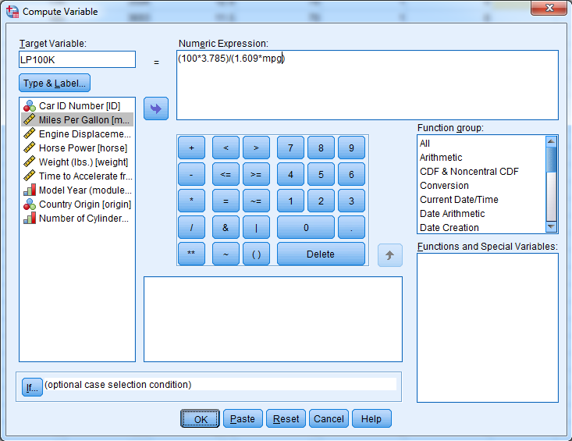

Slide 19
After that new output file will be created with all Descriptive Statistics will be generated in it.
DESCRIPTIVES VARIABLES=mpg engine horse weight accel LP100K
/STATISTICS=MEAN SUM STDDEV VARIANCE RANGE MIN MAX SEMEAN KURTOSIS.

Slide 20
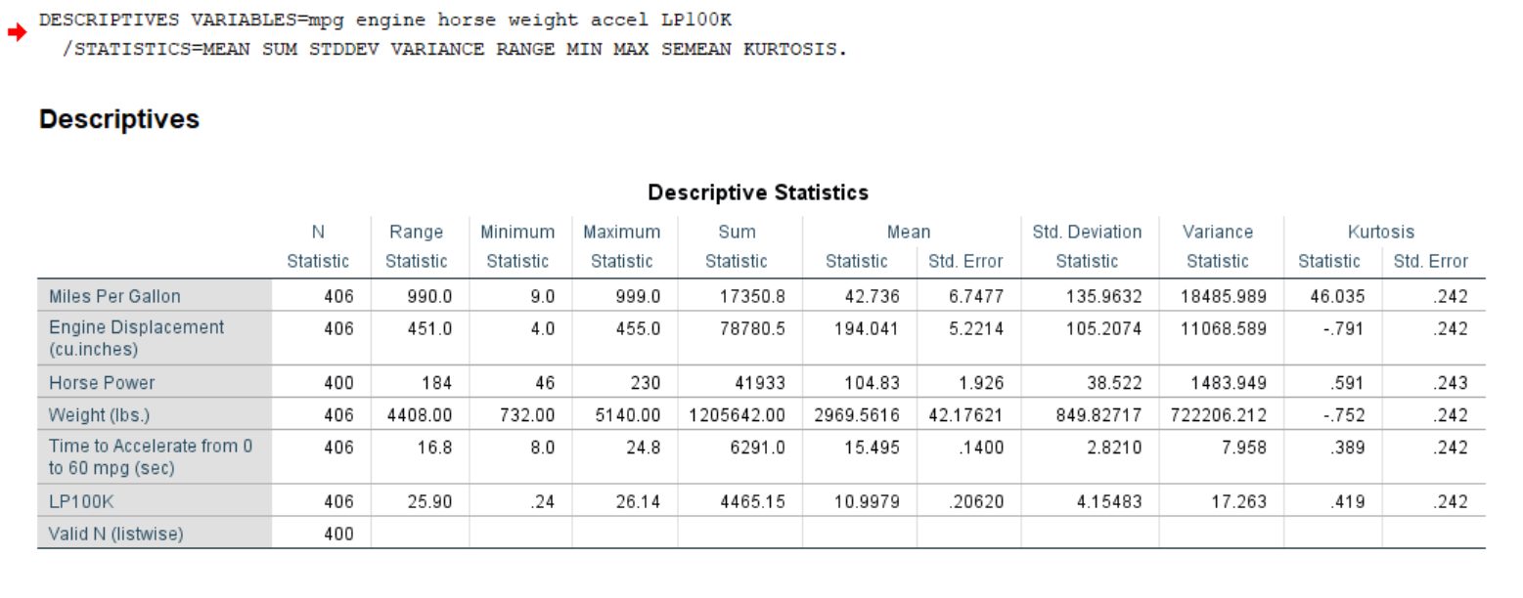

Slide 23
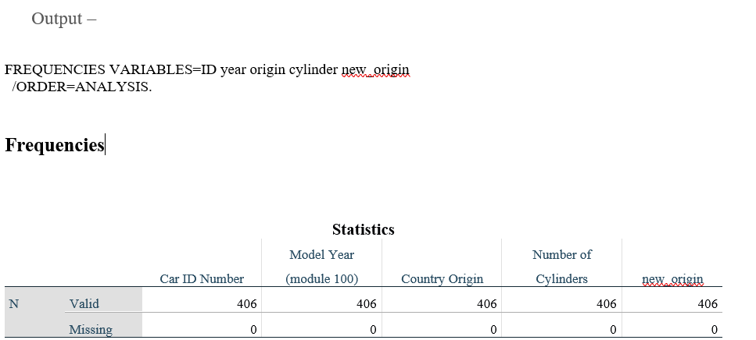

Slide 24
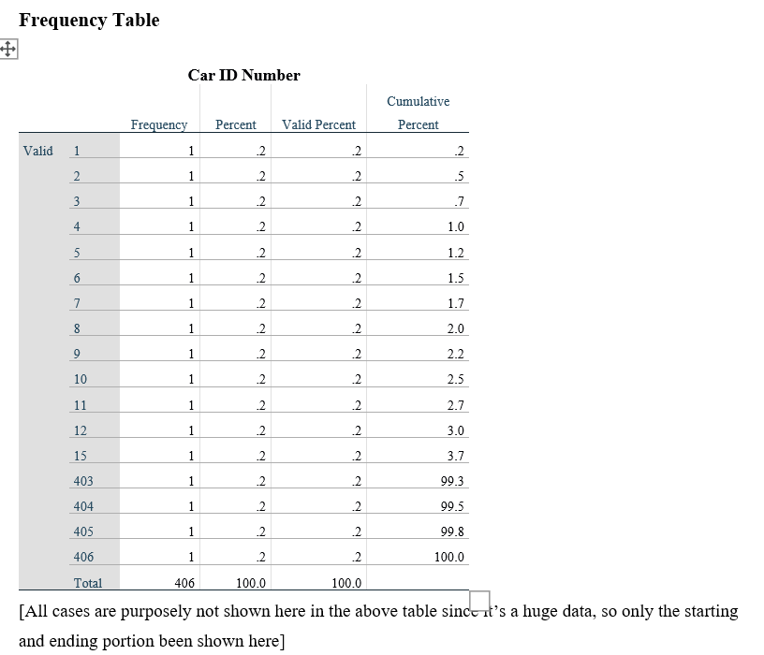

Slide 25
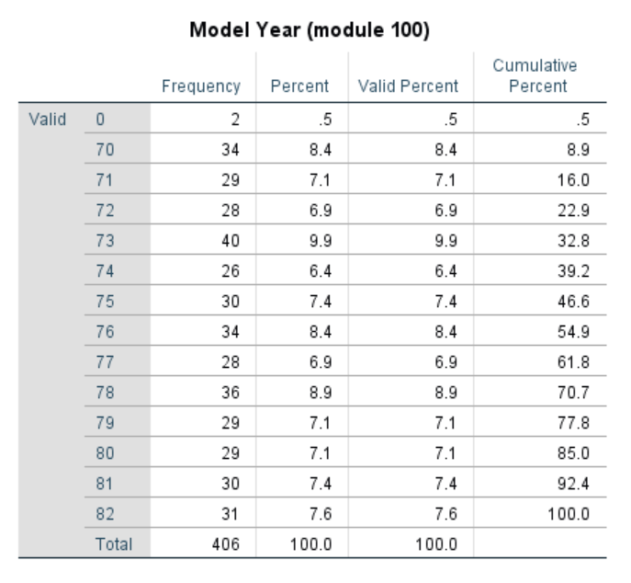
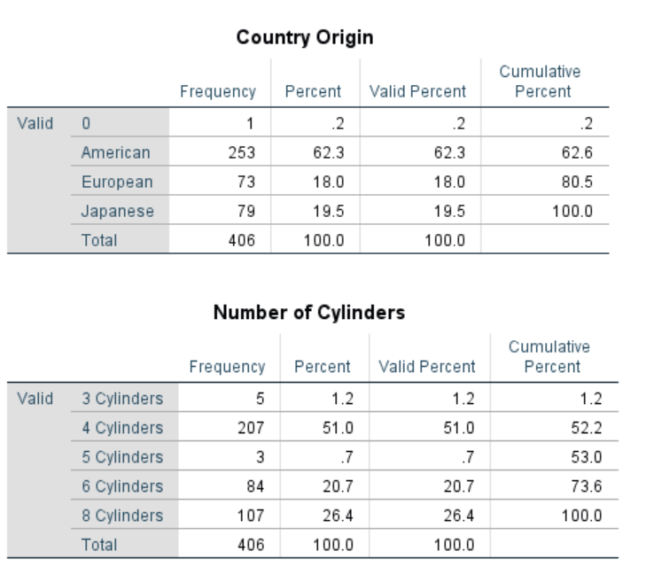

Slide 26
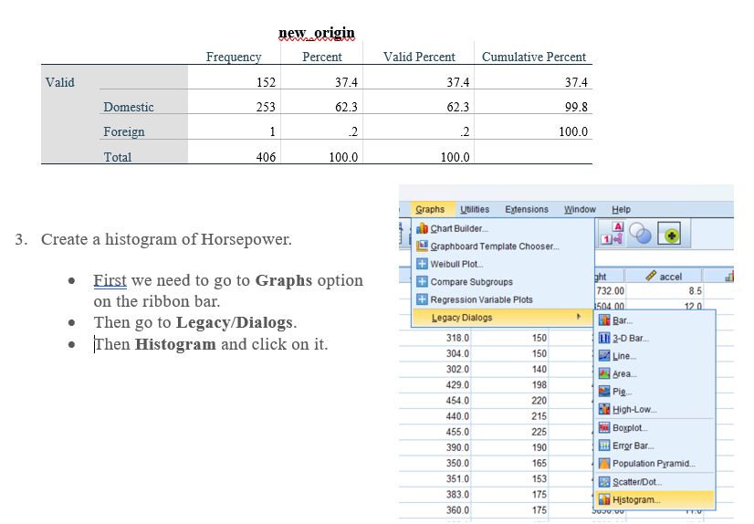

Slide 27
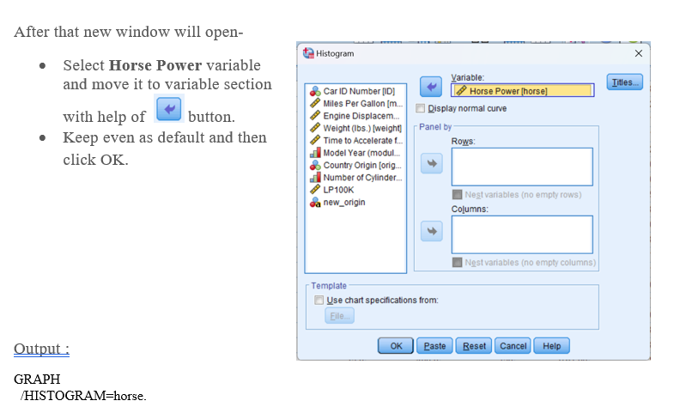

Slide 28
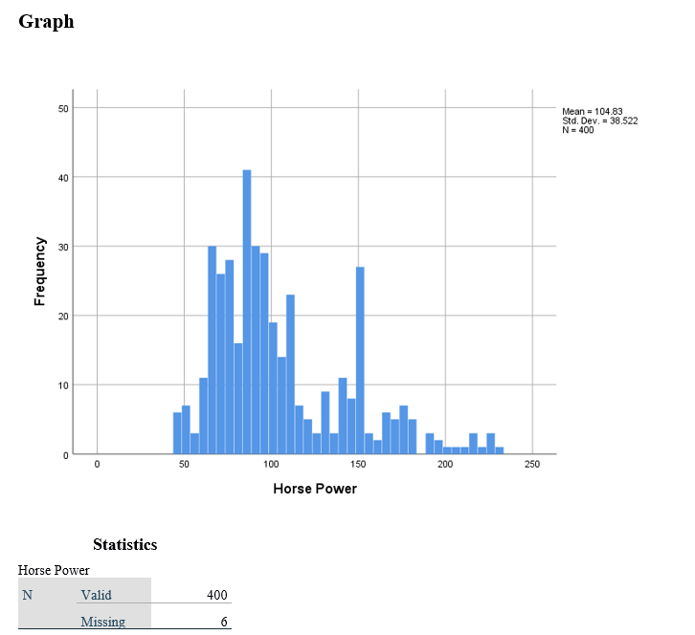

Slide 29
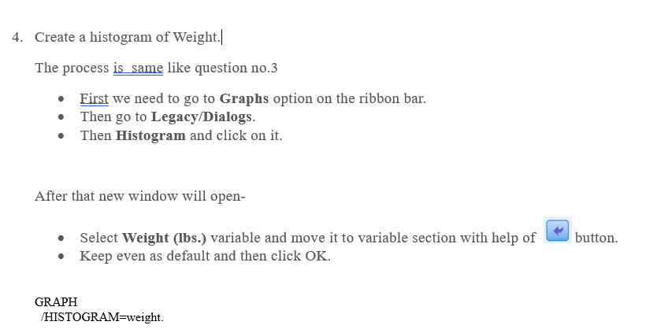

Slide 30
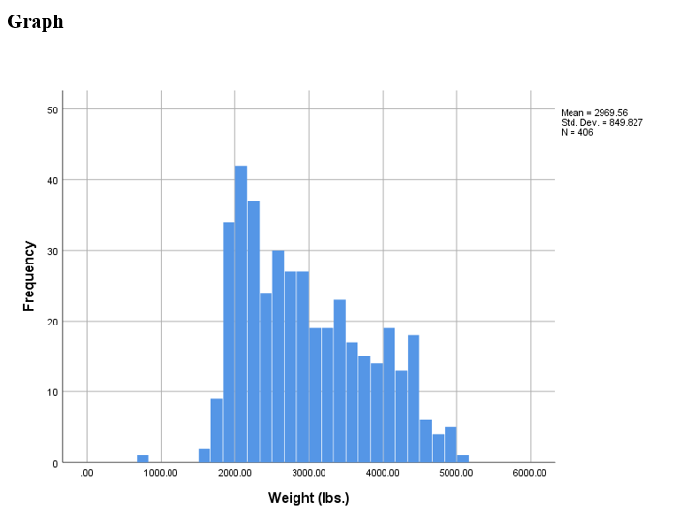

Slide 31
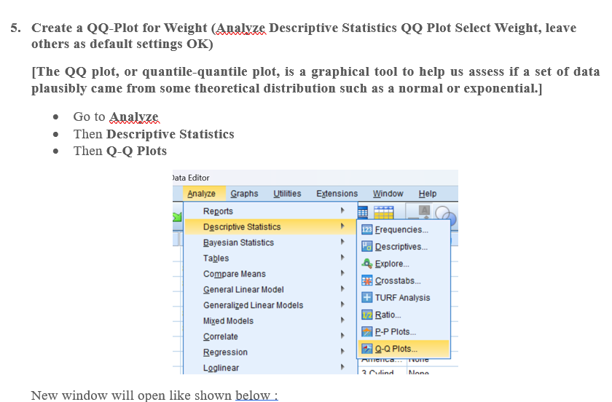

Slide 32
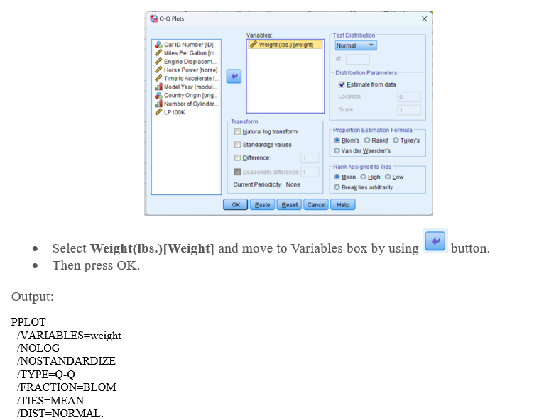

Slide 33
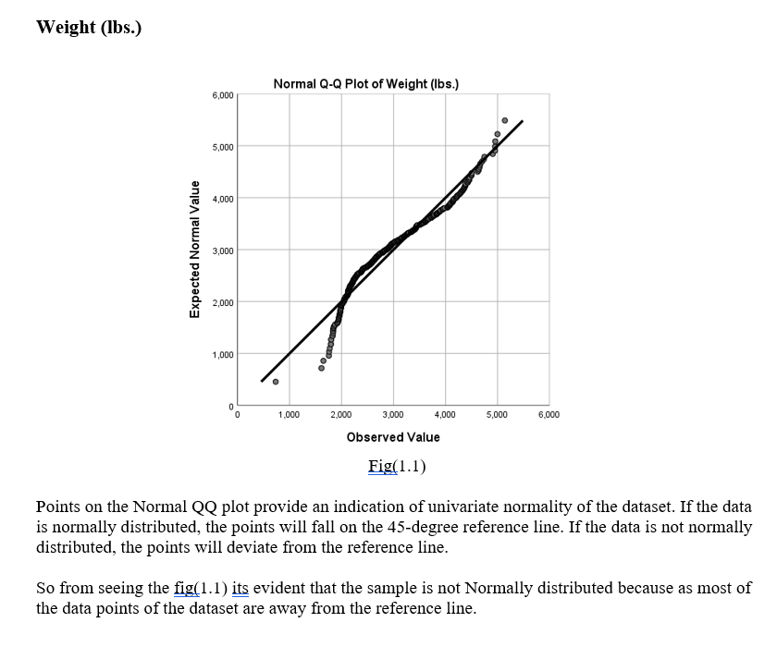

Slide 34
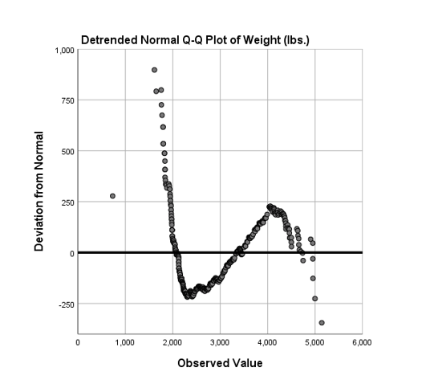
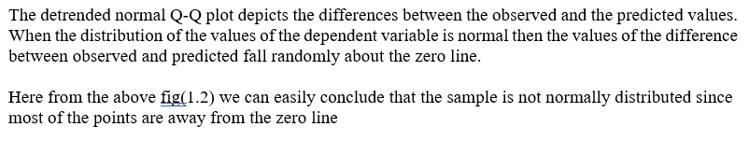

Slide 35
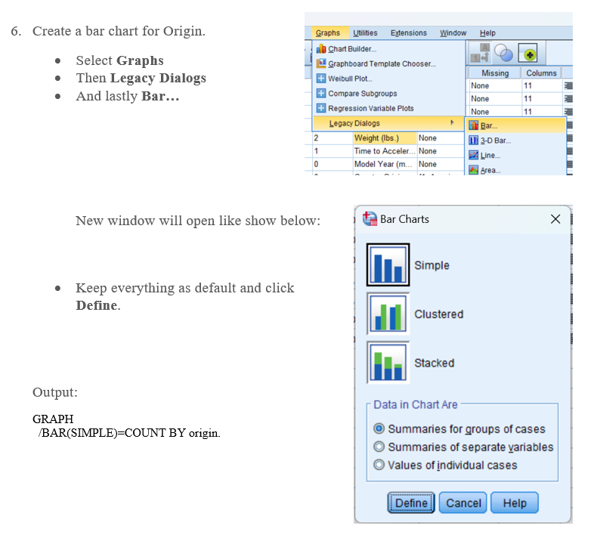

Slide 36
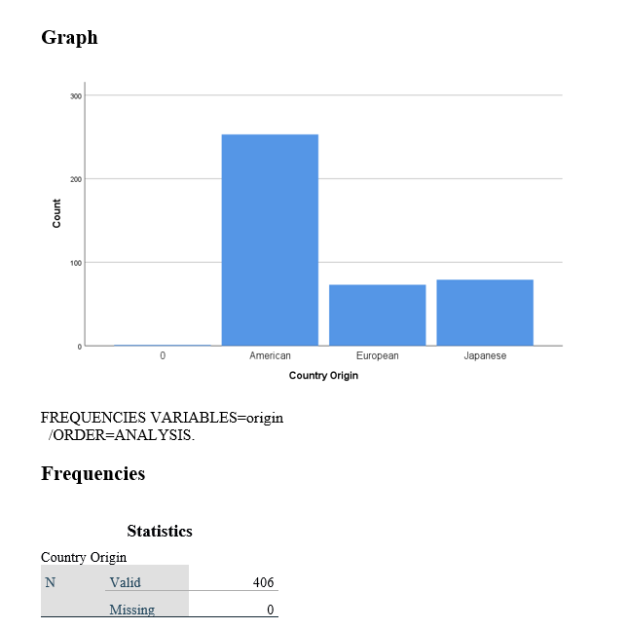

Slide 37
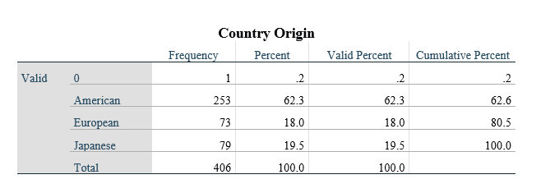

Slide 38
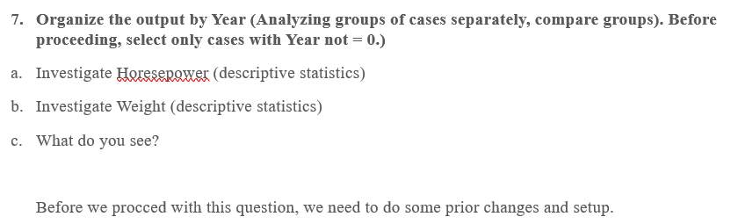

Slide 39
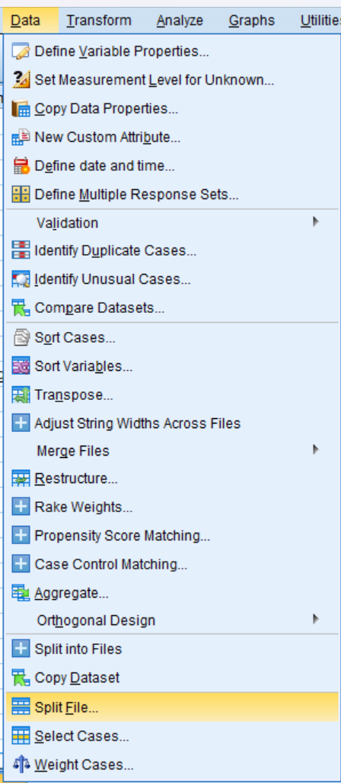
Firstly we need to split file, so that we can analyzing groups of cases separately, here it would be Model year[year]Steps:
• Go to the Data option of the Ribbon bar.
• Then go for Split File at the bottom.

Slide 41
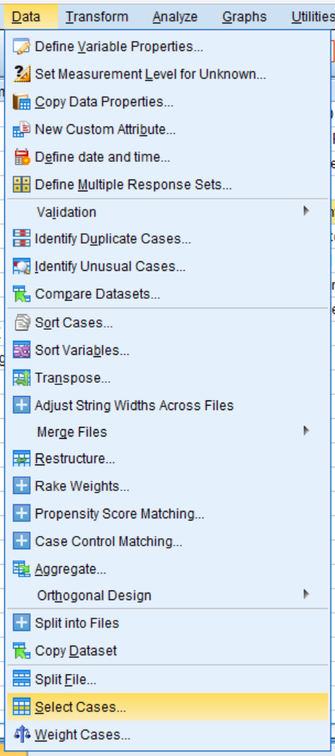
Now next step, we need to select cases… like shown in the picture below:
• Go to the Data option of the Ribbon bar.
• Then go for Select Cases.. at the bottom

Slide 42
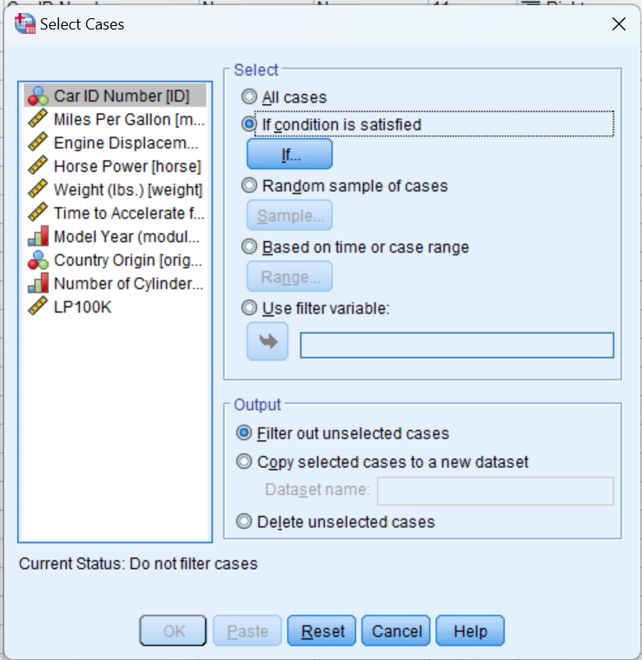
Then new window opens
First select the “If condition is satisfied”
And click If button

Slide 45
Select horsepower and move it to variable(s) and press OK.
Output:
DESCRIPTIVES VARIABLES=horse
/STATISTICS=MEAN SUM STDDEV VARIANCE RANGE MIN MAX SEMEAN KURTOSIS SKEWNESS.

Slide 46
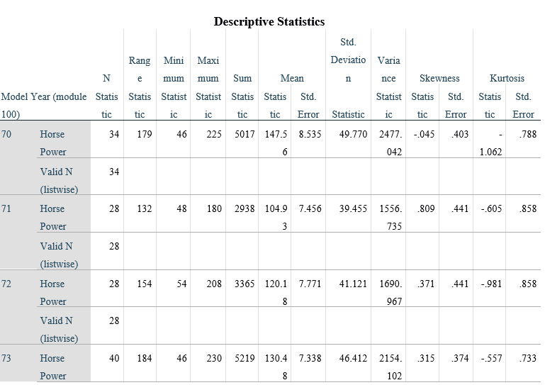
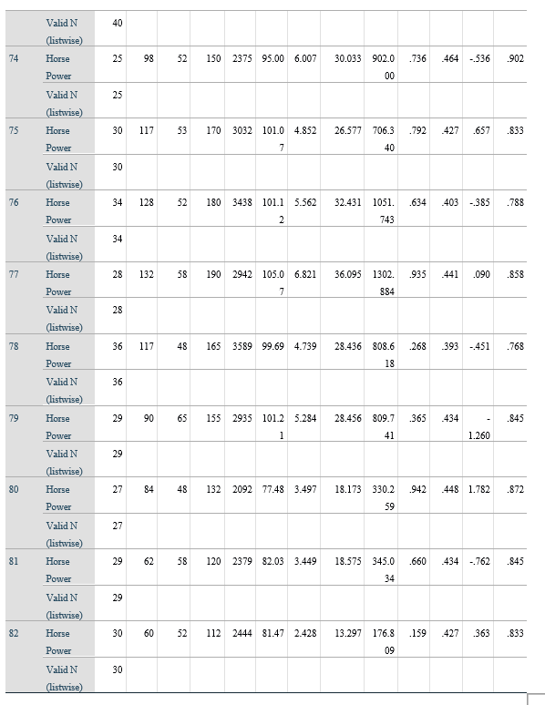

Slide 48
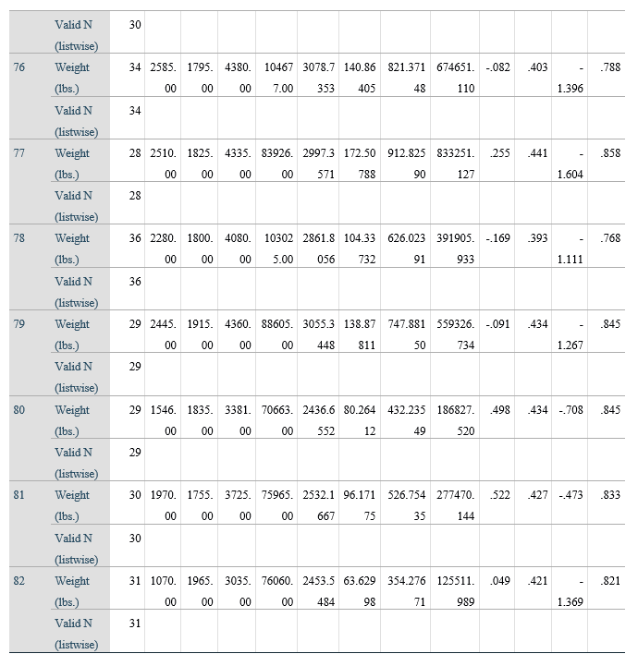
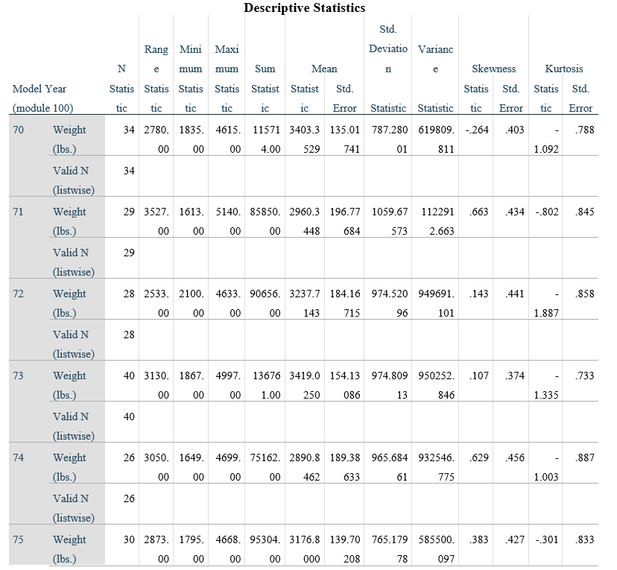

Slide 49
Relationship Between Continuous Y (Horsepower) and Continuous X (Weight)
Create a Scatter Plot with Horsepower as the Y variable and Weight as the X variable.
Add a Linear fit line.
What is the relationship between Horsepower and Weight as shown in this graph?
Before we begin, we need to turn off the split file mode.
Steps :
Just go to Data option on Ribbon bar

Slide 50
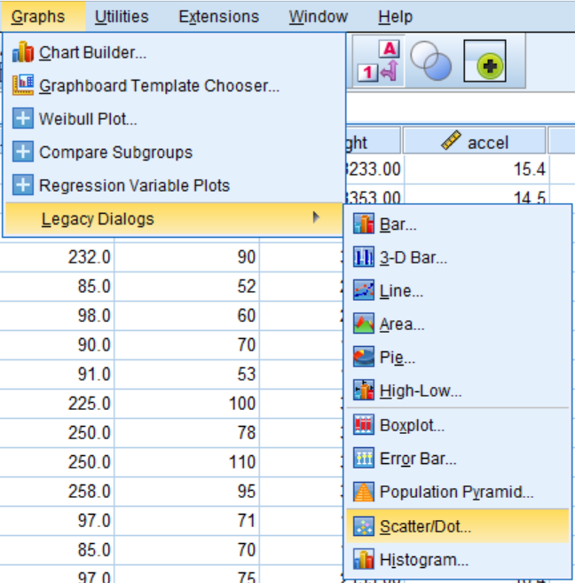
Now we are good to go,
Next step :
Go to Graphs
Then Legacy Dialogs → Scatter/Dot…
New window,

Slide 54
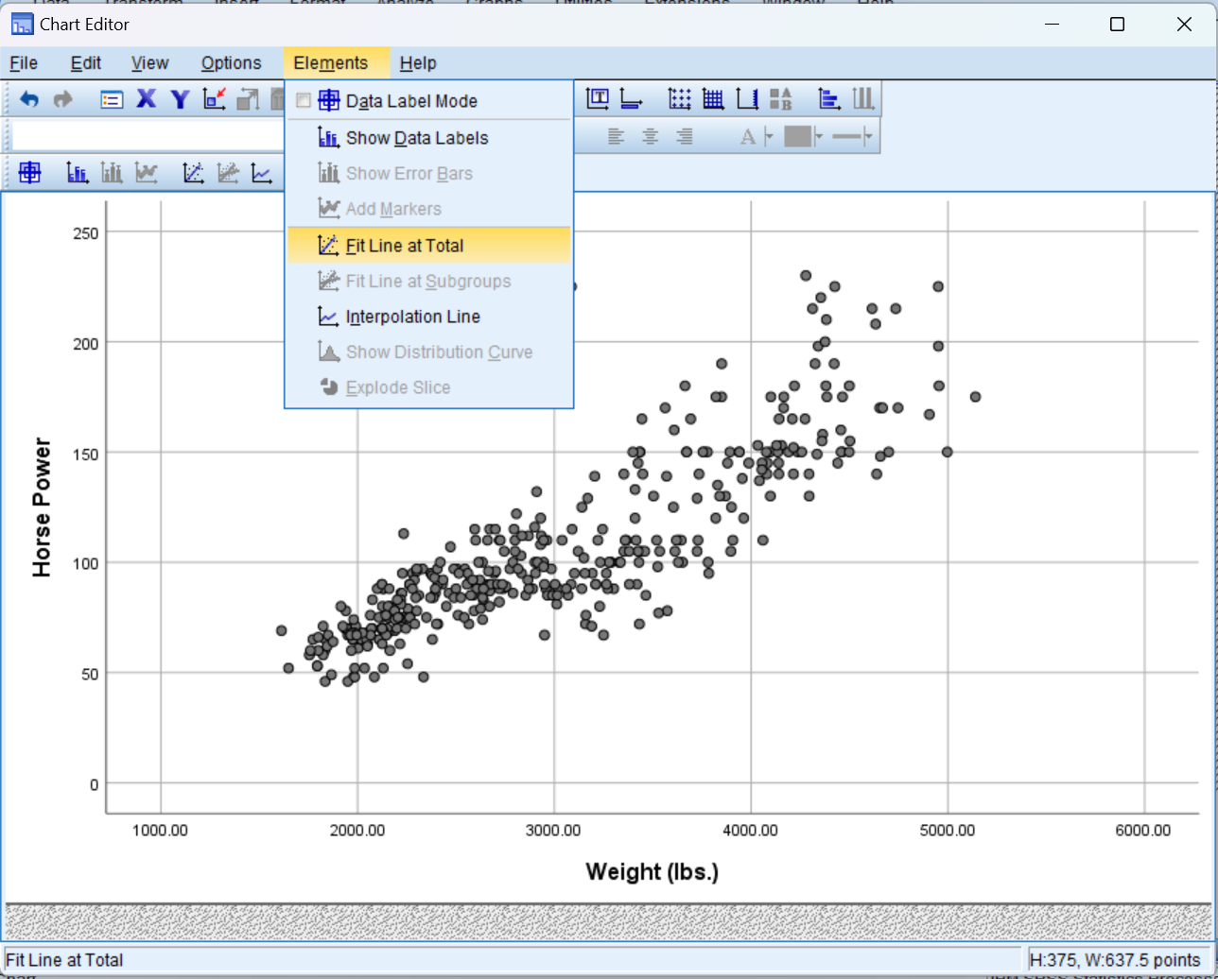

Slide 56
1. Positive Correlation: There is a positive correlation between Horsepower and Weight,.
2. Linear Relationship: The red line represents a linear regression line fitting the data points. The equation of the line is ( y = -12.65 + 0.04x ), where ( y ) is the Horsepower and ( x ) is the Weight. This indicates that for every additional pound of weight, the horsepower increases by approximately 0.04 units.
3. R-squared Value: The ( R^2 ) value of 0.748 suggests that approximately 74.8% of the variance in Horsepower can be explained by the Weight of the car. This indicates a strong linear relationship between the two variables.
In summary, the scatter plot illustrates a strong positive linear relationship between the weight of a car and its horsepower, with heavier cars generally having higher horsepower.

Slide 60
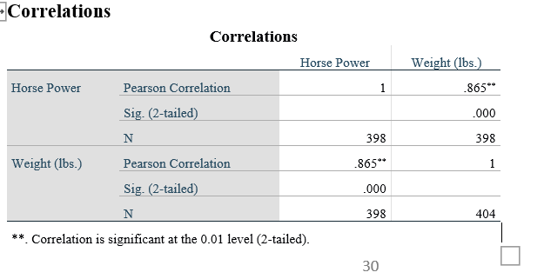

Slide 66
What is the general trend of MPG across years?
The box plot illustrates the distribution of miles per gallon (MPG) for cars across various model years from 1970 to 1982. The general trend in MPG over these years can be summarized as follows:
1. Increasing Trend:
- There is a noticeable upward trend in MPG over the years. The median MPG increases steadily from 1970 to 1982.
- The lowest median MPG is seen in the early 1970s, and the highest median MPG is observed in the early 1980s.
2. Variability:
- The variability in MPG also seems to change over the years. Early in the 1970s, there is higher variability (wider interquartile ranges and longer whiskers), indicating a broader range of fuel efficiencies among cars.
- As we move towards the late 1970s and early 1980s, the variability slightly decreases, suggesting more consistency in fuel efficiency improvements across different car models.
3. Outliers:
- There are a few outliers in certain years (e.g., 1978 ), but they do not significantly alter the general trend of increasing MPG.
- The presence of outliers decreases in later years, indicating that extremely low or high MPG values become less common as overall fuel efficiency improves.

Slide 67
4. Range:
- The overall range of MPG increases over the years. While the minimum MPG values remain relatively stable, the maximum MPG values increase significantly, reflecting advancements in fuel efficiency technology.
In summary, the general trend across the model years from 1970 to 1982 is a steady increase in miles per gallon, indicating that cars have become more fuel-efficient over this period.

Slide 70
The box plot shows the distribution of miles per gallon (MPG) for cars originating from three different regions: American, European, and Japanese. Here are some key observations:
1.Median MPG:
Japanese cars have the highest median MPG, indicating they are generally more fuel-efficient compared to American and European cars.
European cars have a lower median MPG than Japanese cars but higher than American cars.
American cars have the lowest median MPG.
2.Interquartile Range (IQR):
The IQR, which represents the middle 50% of the data, is widest for American cars, indicating greater variability in fuel efficiency among these cars.
European cars have a relatively narrow IQR, suggesting less variability in their MPG.
Japanese cars also show moderate variability but less than American cars.

Slide 71
3.Outliers:
American cars have a few outliers on the higher end, indicating some cars with very high MPG.
European cars have multiple outliers, both high and low, suggesting the presence of both very fuel-efficient and less fuel-efficient models.
Japanese cars have one notable high outlier.
4.Range:
The overall range of MPG is widest for American cars and narrowest for European cars.
Japanese cars fall in between with a relatively moderate range.
In summary, Japanese cars generally have higher fuel efficiency, followed by European cars, with American cars being the least fuel-efficient on average. However, American cars show the greatest variability in fuel efficiency.

Slide 72
Also need to Create a side-by-side Boxplot of Miles per gallon vs. the recoded Country of Origin(1=Domestic, 0=Foreign).
Follow the previous question’s steps
Steps will be exactly same just put new_Origin(the recoded Country of Origin (1=Domestic, 0=Foreign) in Category Axis. That’s it.

Slide 74
What we conclude ?
Key findings from our analysis include:
Descriptive Insights: The central tendencies of key variables revealed.
Correlations: Significant positive/negative correlations were observed between independent and dependent variables (e.g. Horsepower and Weight , indicating positive correlation ).
Q-Q plot : from the Q-Q plotting we discover Weight(lbs) variables are not Normally Distributed
Box Pot : with the help of box plotting we analysed the trends of mpg (miles per gallon) with respect to year and origin.

Slide 75



Slide 76


SCAN ME

